Slide 1


Slide 2
Python Graphical User Interfaces Using GUIZero
Phil Hackett
https://lawsie.github.io/guizero

Slide 3
Console Versus Event-Driven programming
Console based Python applications…
Sequence, Selection, Iteration
Displays text on screen
Waits for input from user
REPL (Read-Evaluate-Print Loop)
Blocking in nature – prevents other actions happening e.g. Using sleep() or while loops

Slide 4
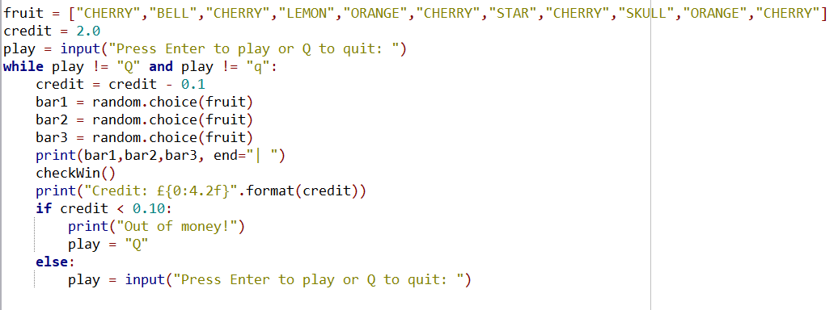
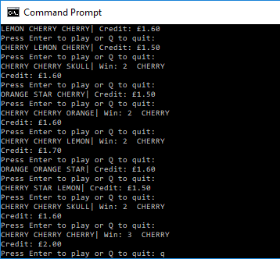
Example program

Slide 5
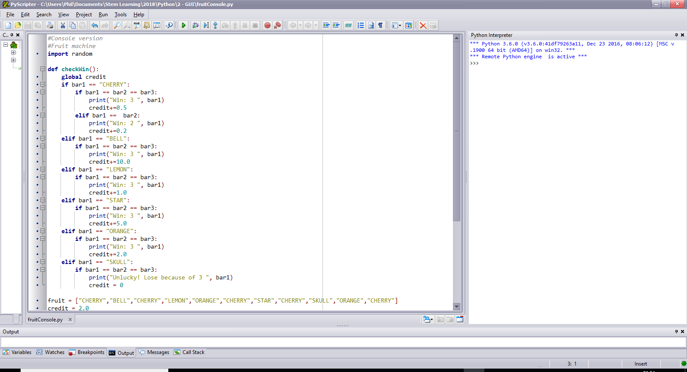
checkWin() procedure
Simple logic checks using selection.
Updates credit variable if a win occurs (or loss).
Hands control back to the main program to continue
REPL.

Slide 6
GUI (Event-Driven)
Windows
Buttons
Text Labels
Text Boxes
Pictures
Radio buttons
Alerts / popups
And more…

Slide 7
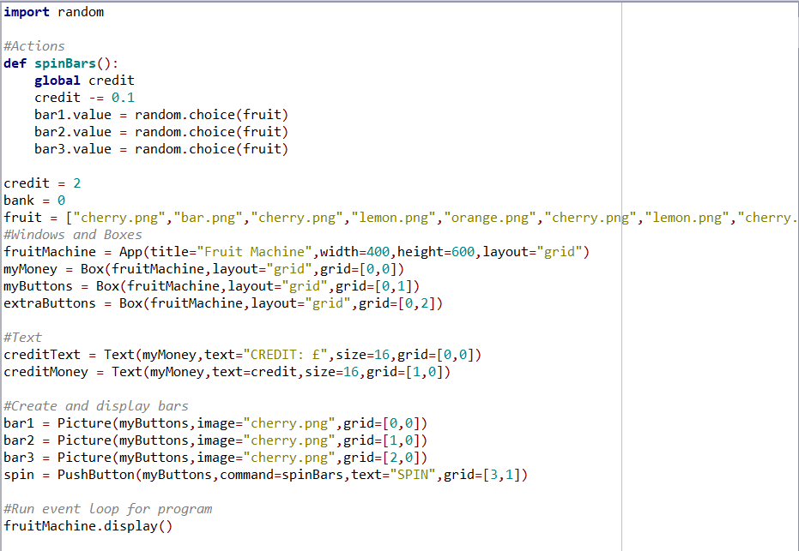
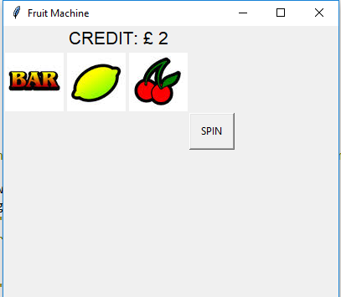
GUI (Event-Driven)
Window
Text
Picture
Buttons

Slide 8
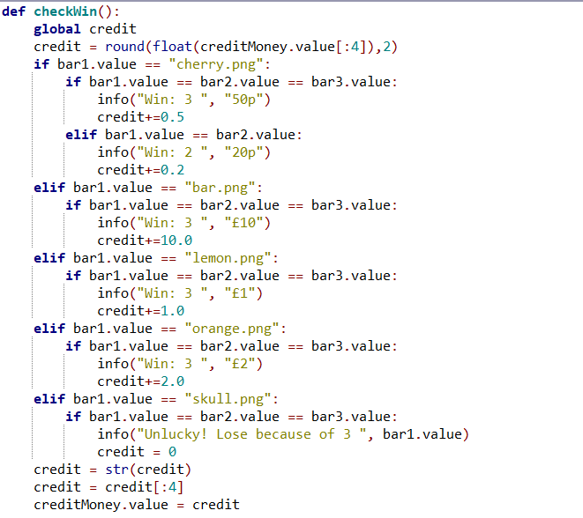
The logic of the GUI version is the same as the console version.
Notes:
Whilst there is extra to think about, the underlying problem is solved using the same / similar algorithms.

Slide 9
This session
Why – Code challenges
Consider using Python as a GUI based program
Consider the requirements to enable students to plan GUI based programs
Exposure to GUIZero features and methodology
Creation of a simple, functional program

Slide 10
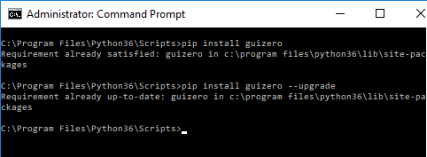
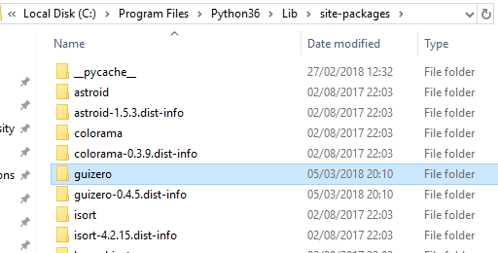
Using GUIZero at School
Command line install
At Administrator command prompt
Go to ..\PythonX\Scripts directory
Enter pip install guizero
For upgrade, add --upgrade
Copy folder over
Download and copy folder into site-packages folder
UPDATE OCCURRED:
10th APRIL!
Lots of new features!
0.4.5 -> 0.5

Slide 11
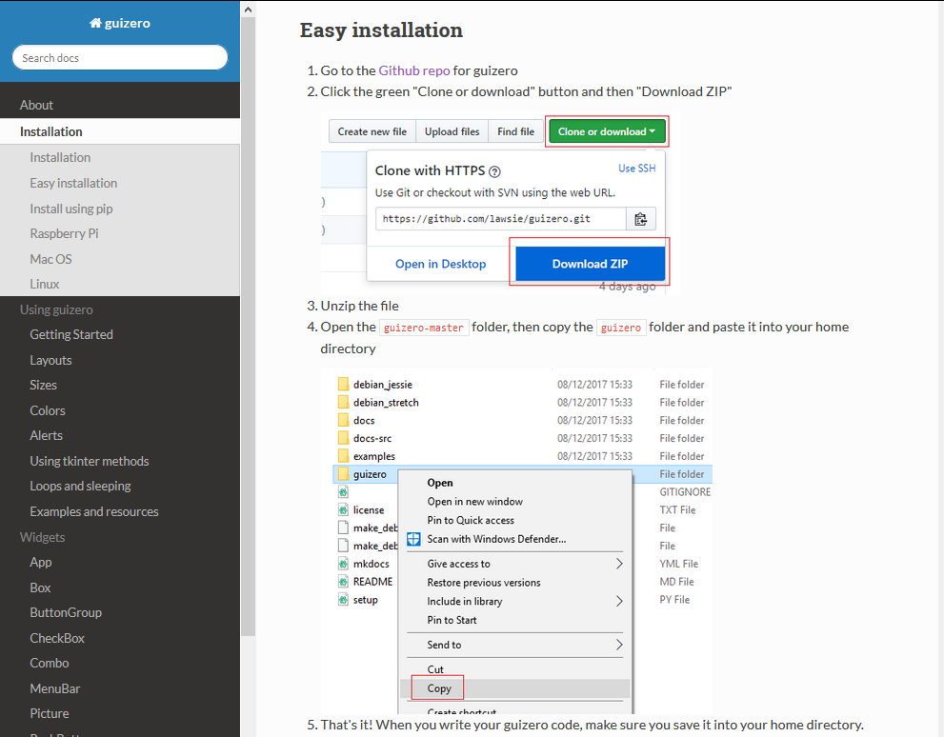
https://lawsie.github.io/guizero/#easy-installation

Slide 12
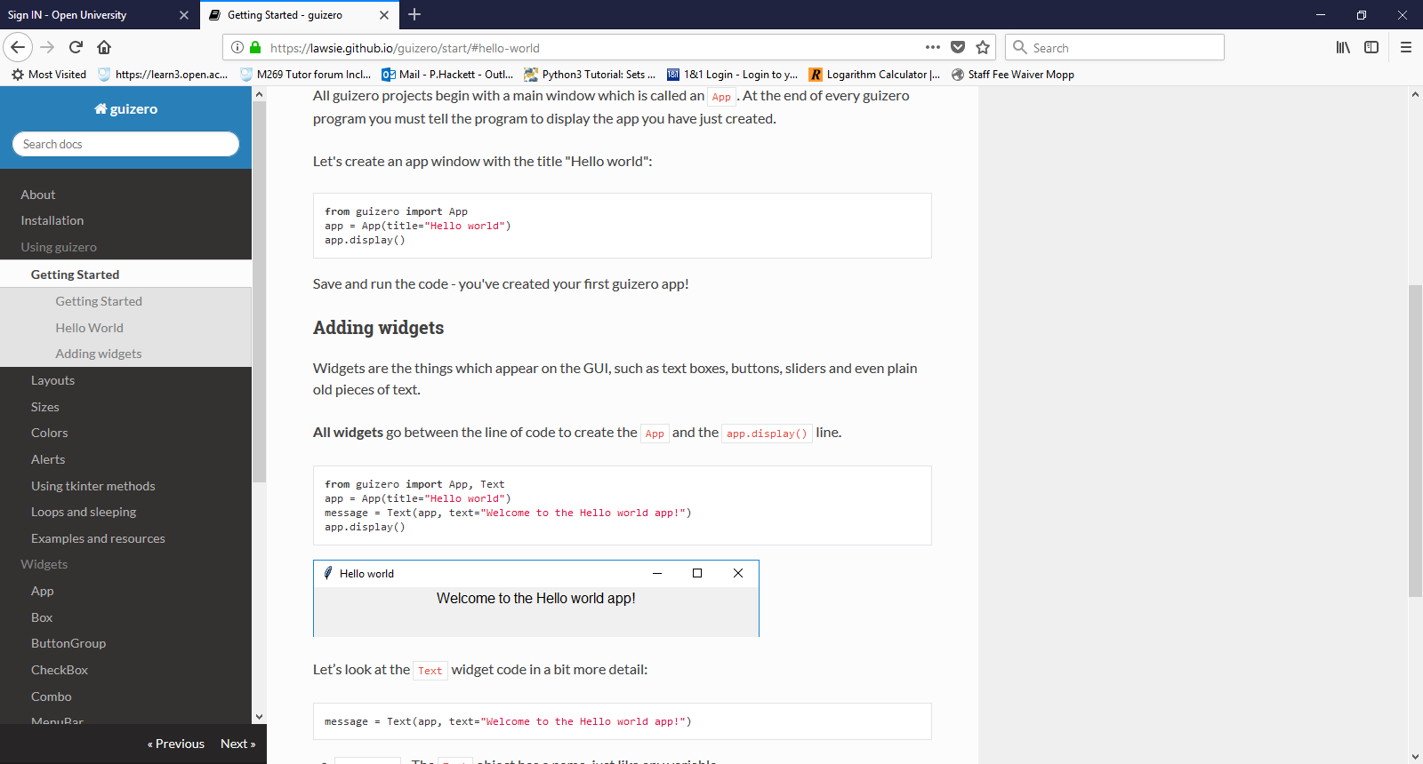
GUI Zero programming methodology
Each item has
Starting parameters. These usually include compulsory settings.
Methods. The action that the item can carry out.
Properties. This allows changing the look and layout of the item.
Importing
Each feature needs to be imported to use i.e. to use any text labels you need to import Text. Every GUIZero program needs to import the App library to display a window. All items reside inside an App.

Slide 13
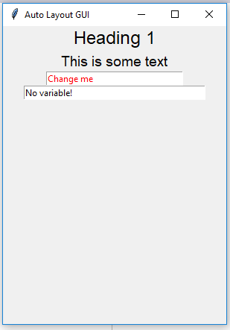
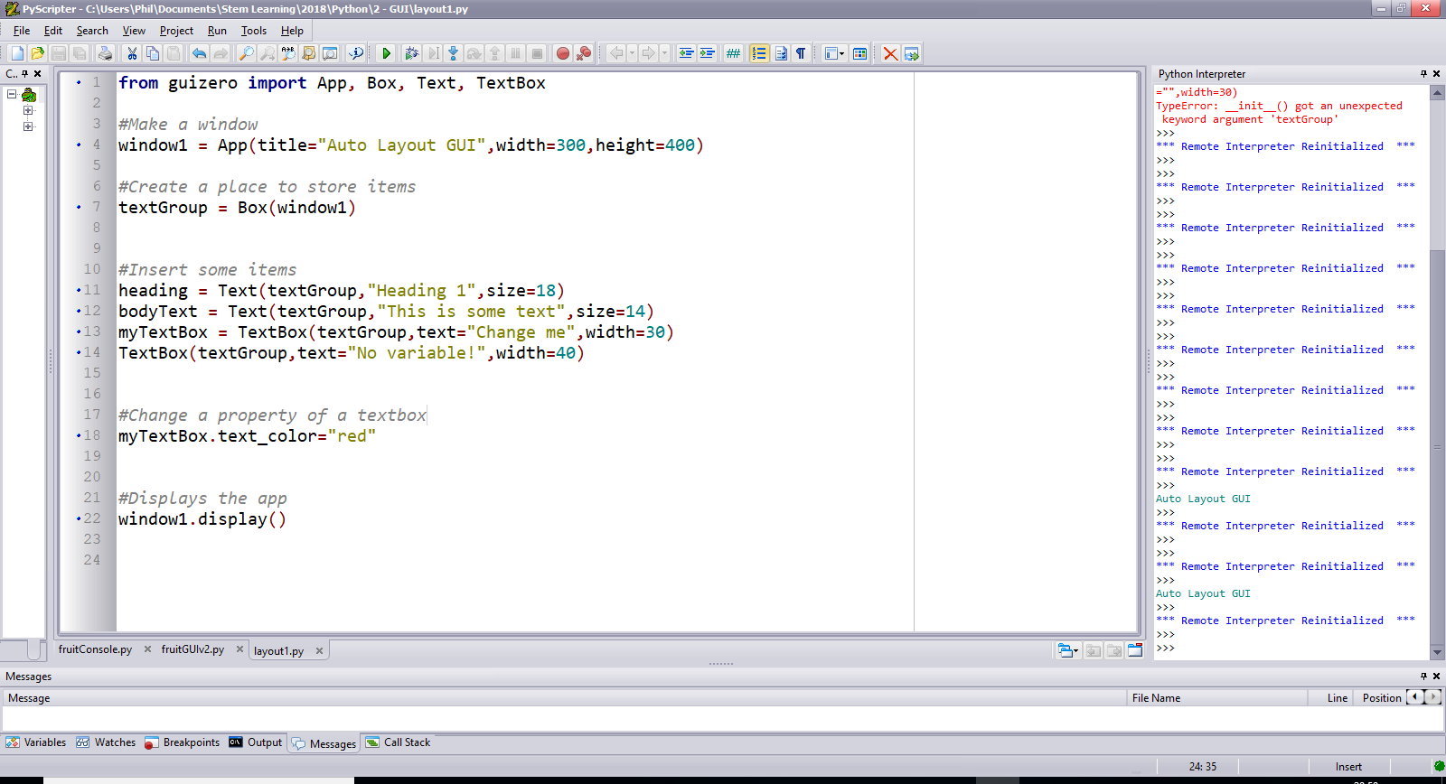
Layout
Automatic layout
Items appear in the order they are created
Items are centred in the middle of the App
Adding Basic items

Slide 14
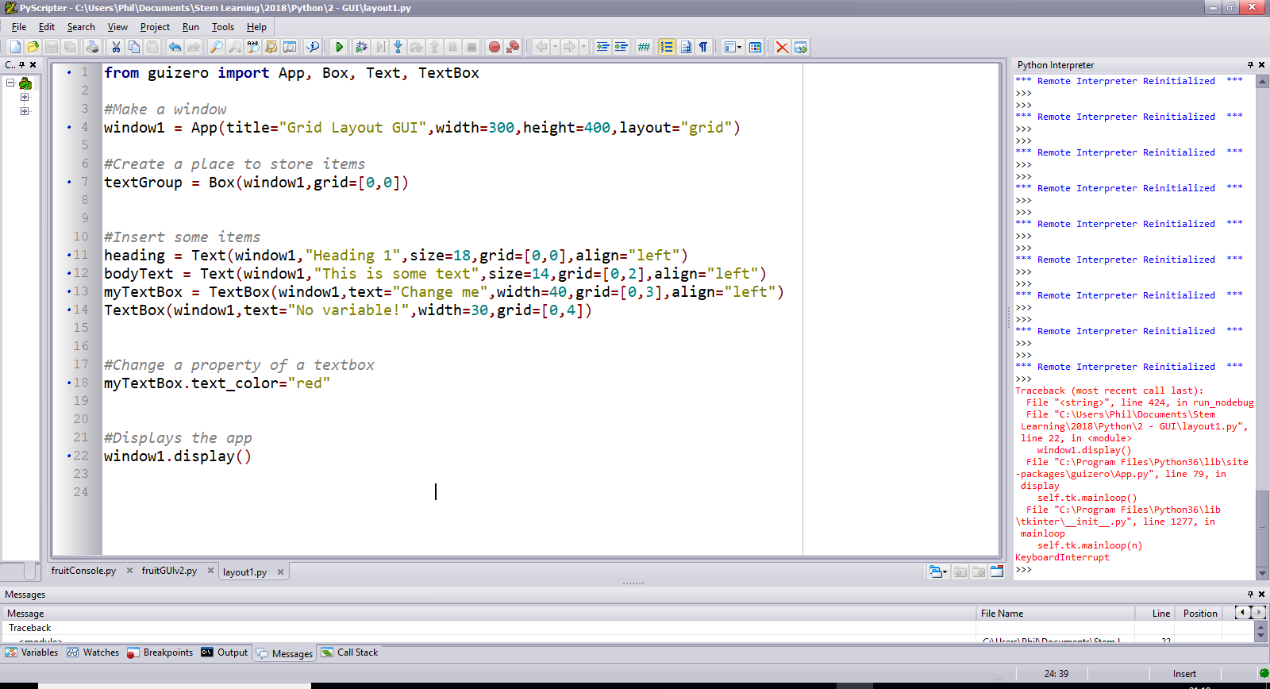
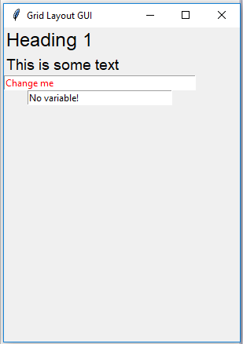
Grid Layout
Usual method of laying out GUI elements
Much greater control over the location of elements
Requires more code and greater thought in planning layout
Layout1.py

Slide 15
Grid Layout
Usual method of laying out GUI elements
Much greater control over the location of elements
Requires more code and greater thought in planning layout

Slide 16
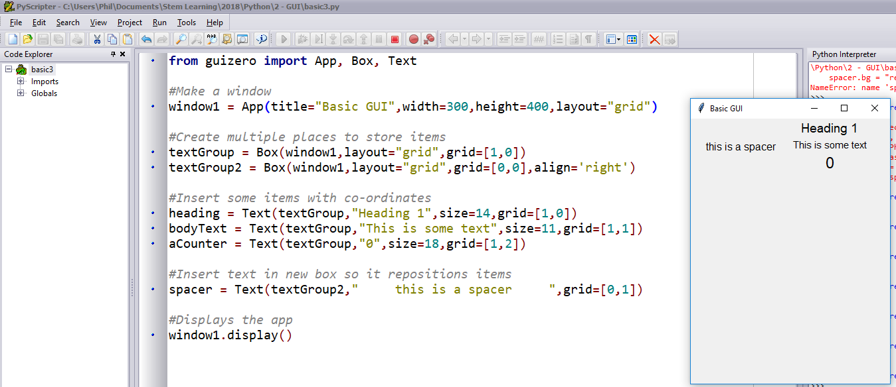
Example side-by-side Layout
basic3.py

Slide 17
Planning Layout
Planning requires thought regarding what you want to appear and where you want it to appear
Similar items should be placed in a Box. Every Box resides inside an App.
Sketching the layout – pupils could use…
Paper
Evolus Pencil
DTP software

Slide 18
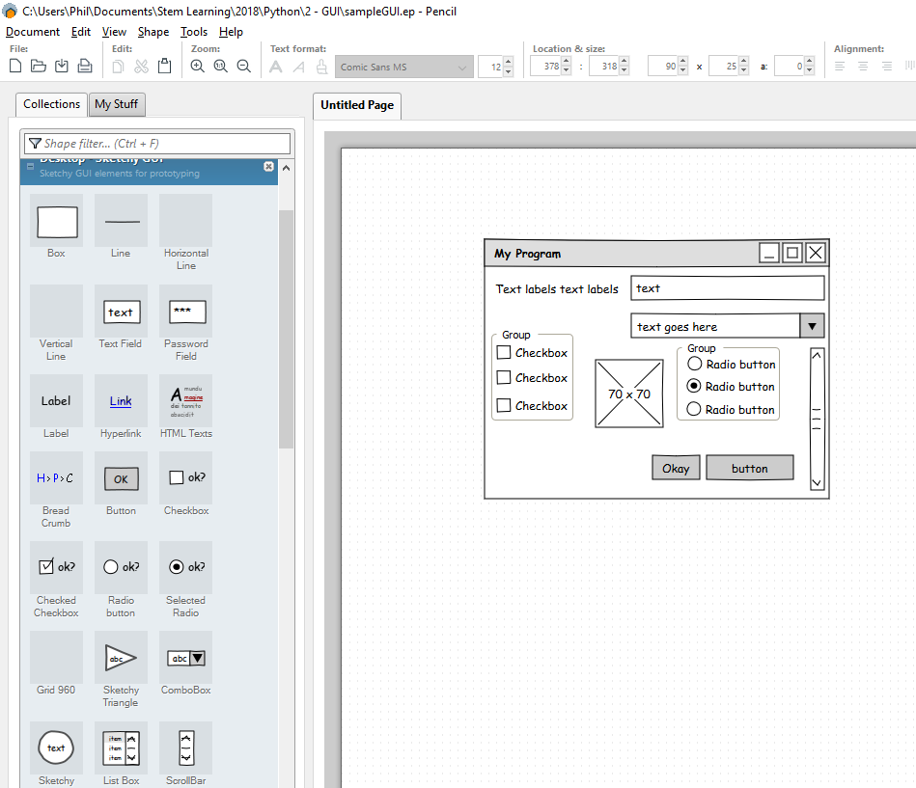
Evolus Pencil
Free software to create User Interfaces

Slide 19
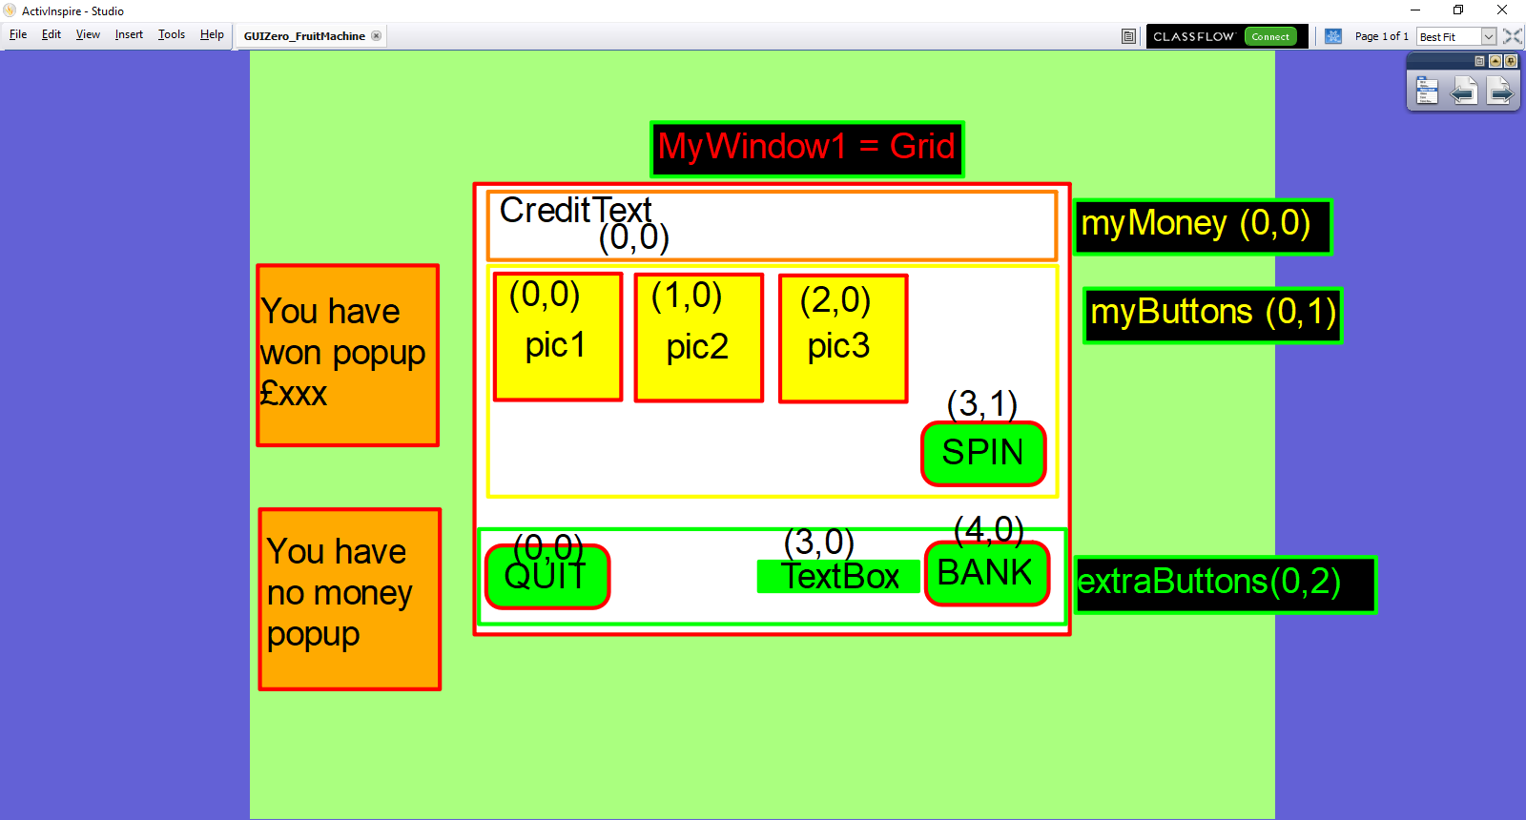
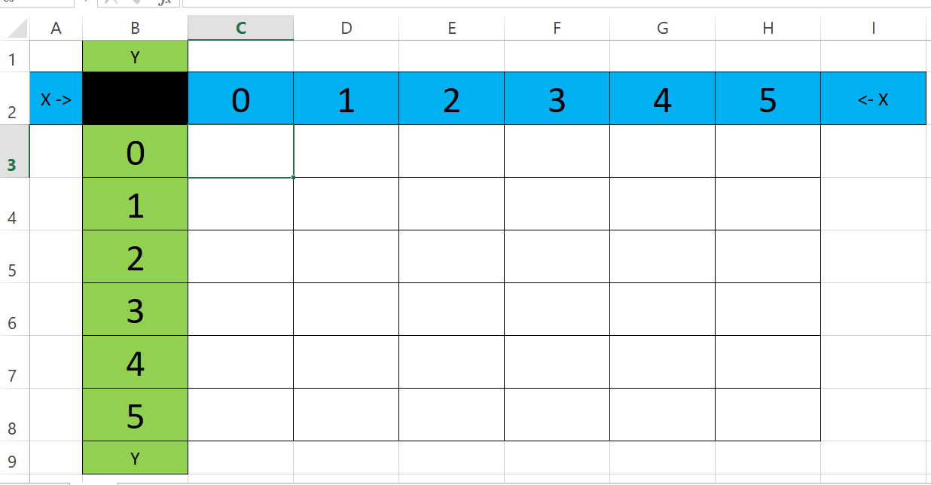
Other Software

Slide 20
Take care with grid positions! Empty spaces are ignored!
MyWindow1 is the App
myMoney, myButtons, extraButtons are all Boxes
CreditText is inside myMoney
pic1, pic2, pic3, spin are inside myButtons.
Notice the choice of grid positions here

Slide 21
Summary
We have looked at:
Event-Driven Programming
GUIZero as a solution
Inserting Text (labels) in to an App
Using Boxes
Using the Grid layout

Slide 22
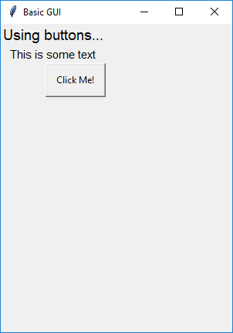
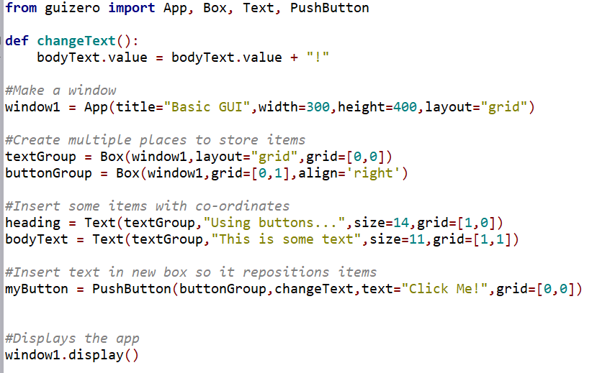
Using Buttons in GUIZero
https://lawsie.github.io/guizero/pushbutton/
basic4
Pushing a button is an event that triggers a function

Slide 23
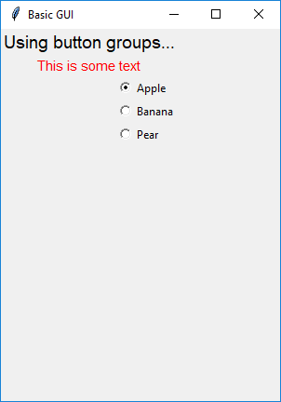
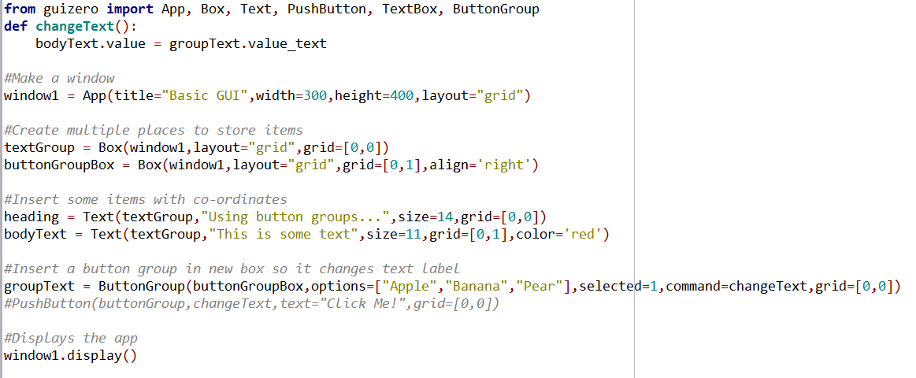
Button Groups
https://lawsie.github.io/guizero/buttongroup/
Notice you can get and set the properties of all items
Notes:
GUI is advanced1.py

Slide 24
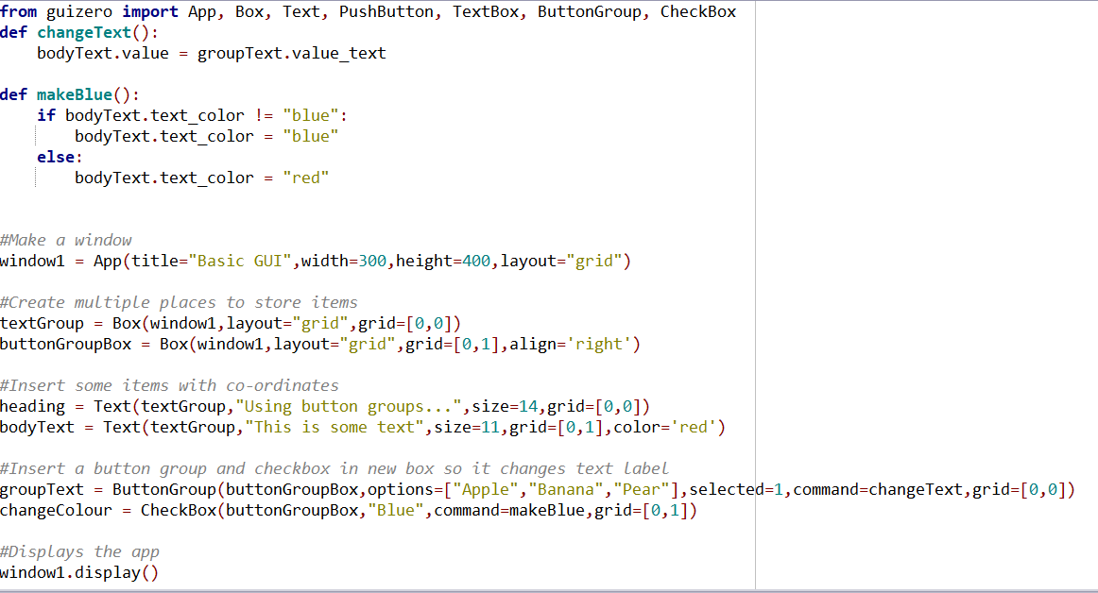
Check Box
advanced1.py

Slide 25
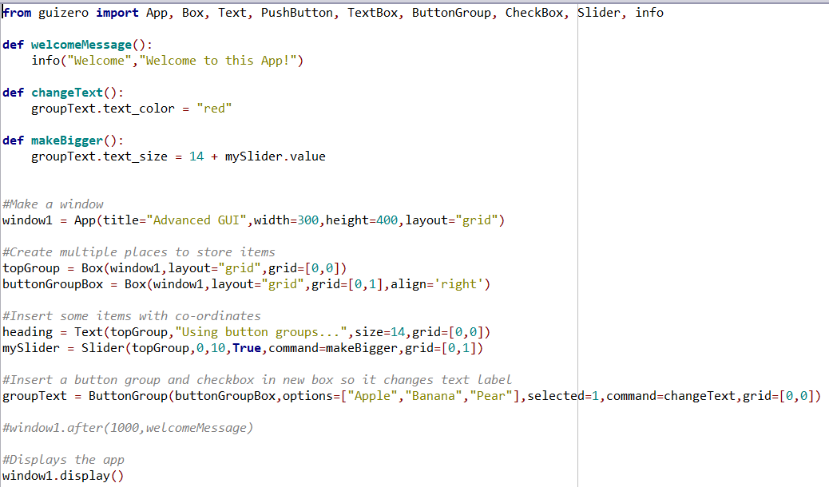
Slider
advanced2.py

Slide 26
Alerts and call-backs
There are 4 kinds of alerts:
Warnings: Requires Okay to be pressed = warn
Information: Requires Okay to be pressed = info
Errors: Requires Okay to be pressed = error
Yes / No: Requires yes (True) or no (False) to be pressed = yesno
Call-backs allow the calling of functions
Call-backs can be set on many items, including Apps, through GUIZero.
These allow actions to occur once or repeatedly after a set amount of time or all of the time i.e. every time a button is pressed.

Slide 27
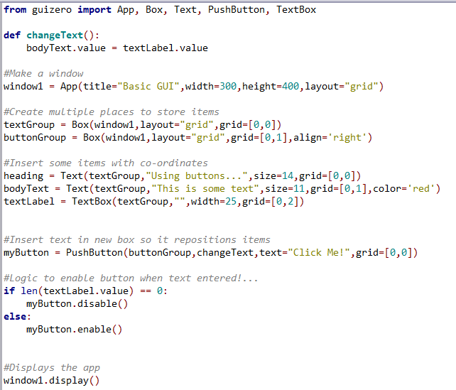
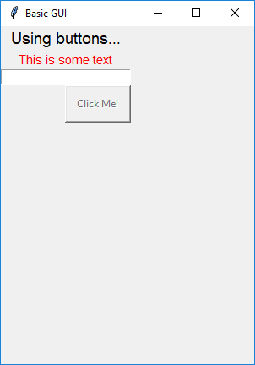
Wrong logic
The requirement is to not be able to type, if no text is entered in textLabel
What would happen here?
basic6

Slide 28
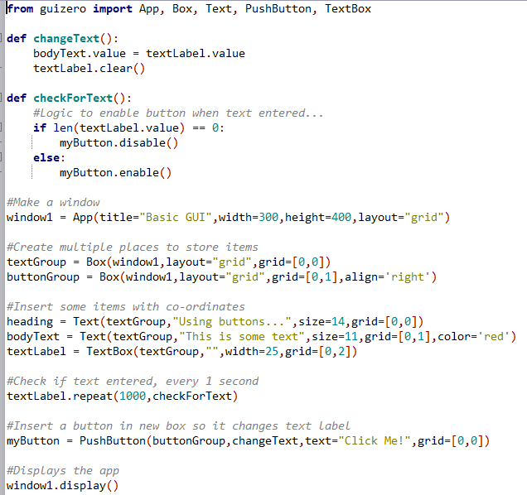
Correct logic
Every second, the text box (textLabel) is checked to see if any text has been added. If yes, the button is enabled.
basic6

Slide 29
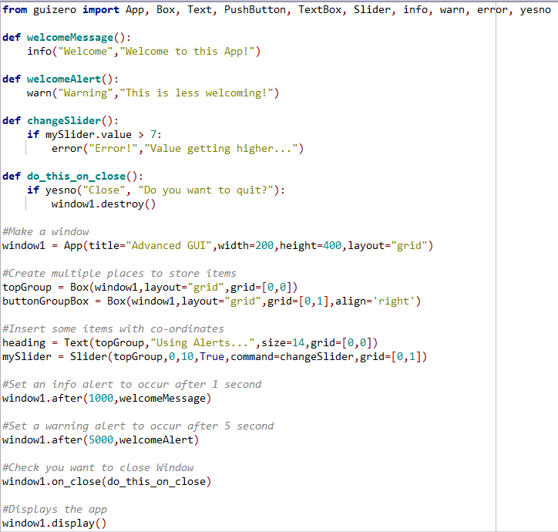
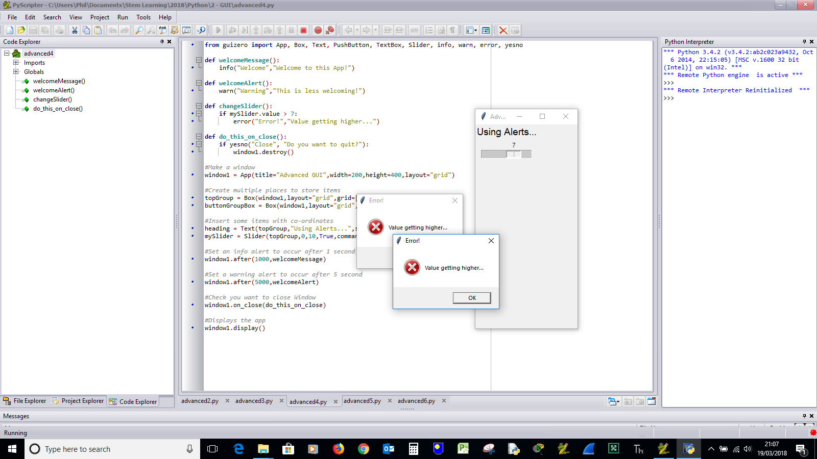
Using after / repeat call-backs
advanced4.py

Slide 30
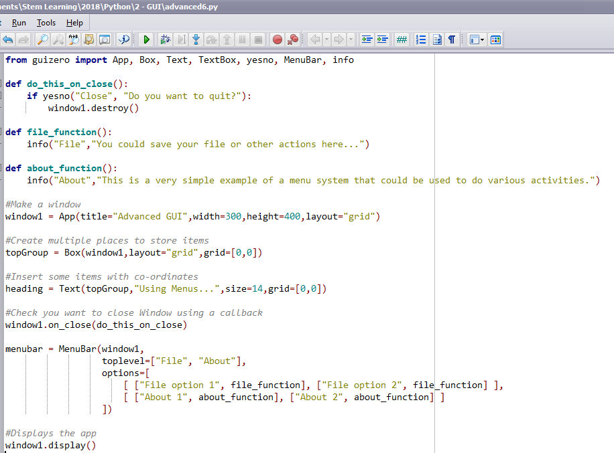
Menu Bar

Slide 31
Make a GUI containing
Menu
Menu Functions / alerts
Text (Labels)
Text Boxes
Buttons
Button Groups
GUI should display a bank balance. When a button is clicked, depending on other options it should deposit or withdraw money from the bank account i.e. increase or decrease the balance
Alternative: Fruit Machine / Tic-Tac-Toe / Other

Slide 32
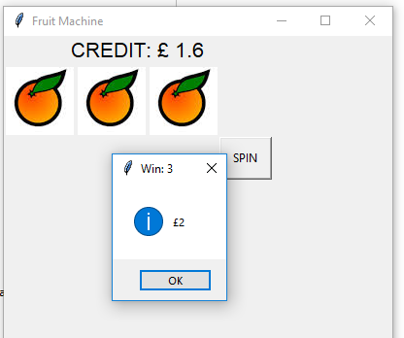
Example: Improved Fruit Machine
Include Radio Buttons to signify stake.
Stake could be multiplied by fruit value
Allow money to be banked
Allow ‘holding’ of some reels
Provide a ‘frequency tracker’

